Slide 1
PRAM ALGORITHMS
Session-5

Slide 2
PRAM Algorithms
Introduction:
So far we have discussed algorithms for single processor
In this session, we introduce parallel machines
Example: weather forecasting
If you start today to forecast tomorrow's weather using single processor you may get result after few days (since its a Compute-intensive problem)

Slide 3
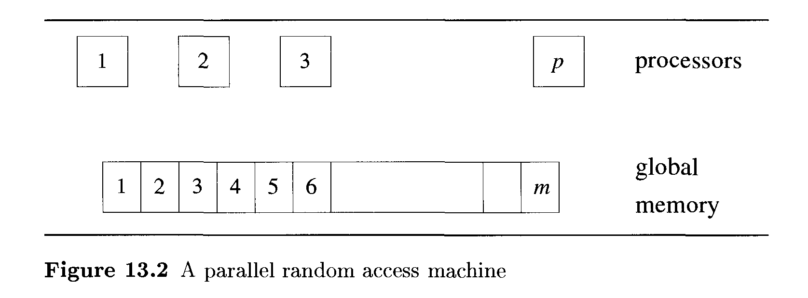
PRAM Model
So we need multiple machines/processors to solve such type of problems.
Parallel machines offer the potential of decreasing the solution time enormously.

Slide 4
The idea of parallel computing is very similar.
Given a problem to solve, we partition the problem into many subproblems; let each processor work on a subproblem; and when all the processors are done, the partial solutions are combined to arrive at the final answer.
Any algorithm designed for a single-processor machine as a sequential algorithm
Any designed for a multiprocessor machine as a parallel algorithm.

Slide 5
Sorting
Given a sequence of n keys, the problem of sorting is to rearrange the given sequence either in ascending or descending order.

Slide 6
PRAM SORTING:
ODD-EVEN Sort Algorithm:
Step 0: If n ≤ 1, return X.
Step 1: Let X = k₁,k₂,k₃,… k_{n} be the input. Partition the input into two:
X₁’ = k₁,k₂,…..k _{n/2} and X₂’ = k_{n/2+1} , k_{n/2+2},….. K_{n}.

Slide 7
PRAM SORTING:
ODD-EVEN Sort Algorithm:
Step 2: Allocate n/2 processors to sort X₁’ recursively. Let X₁ be the result.
At the same time employ the other n/2 processors to sort X₂’ recursively.Let X₂ be the same.
Step 3: Merge X₁ and X₂ using PRAM MERGE Algorithm and n = 2m processors.

Slide 8
Example
X= 10,7,15,12,5,9,16,20,25,42,39,37,21,14,8,15
X₁’= 10,7,15,12,5,9,16,20 X₂’=25,42,39,37,21,14,8,15
Sort
Sort
5,7,9,10,12,15,16,20
8,14,15,21,25,3739,42
Odd
Even
Odd
Even
5,9,12,16
7,10,15,20
8,15,25,39
14,21,37,42
Odd merge
Even merge
L1: 5, 8, 9, 12,15,16,25,39
L2 : 7, 10,14,15,20,21,37,42
Shuffle
L : 5, 7,8,10,9,14,12,15,15,20,16,21,25,37,39,42
Compare
5, 7,8,9,10,12,14,15,15,16, 20,21,25,37,39,42

Slide 9
Sort the following sequence using odd-even sort
algorithm
X={ 4,6,3,17,14,11,2,34,7,5,12,45,21,19,11,32}

Slide 10
Thank you

